Slide 1
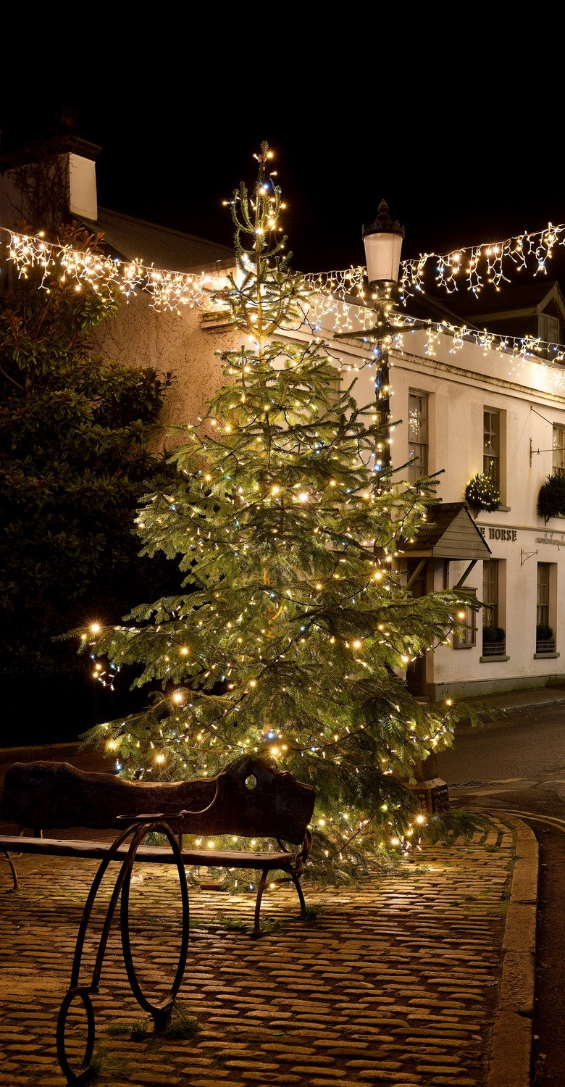
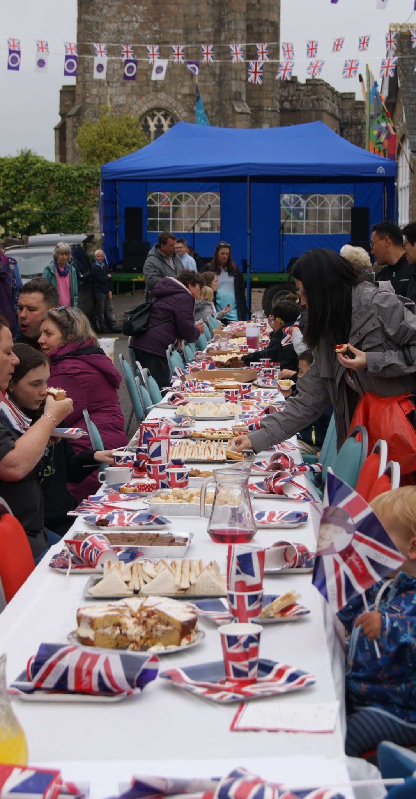
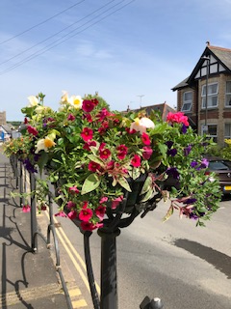
What does the Council do?

Slide 2
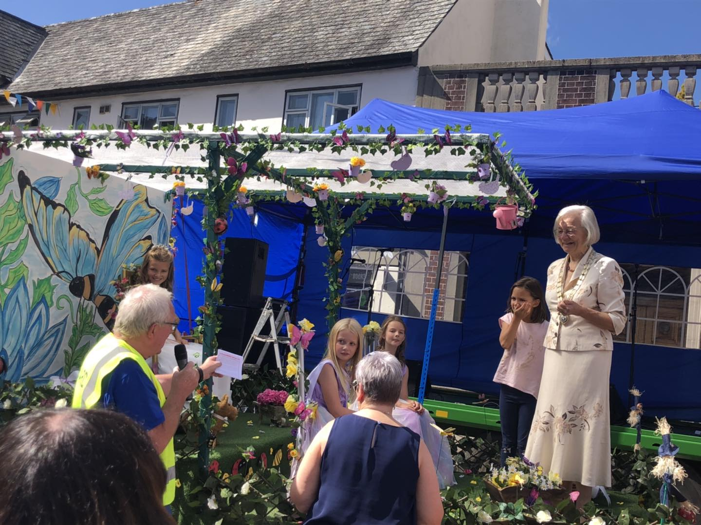
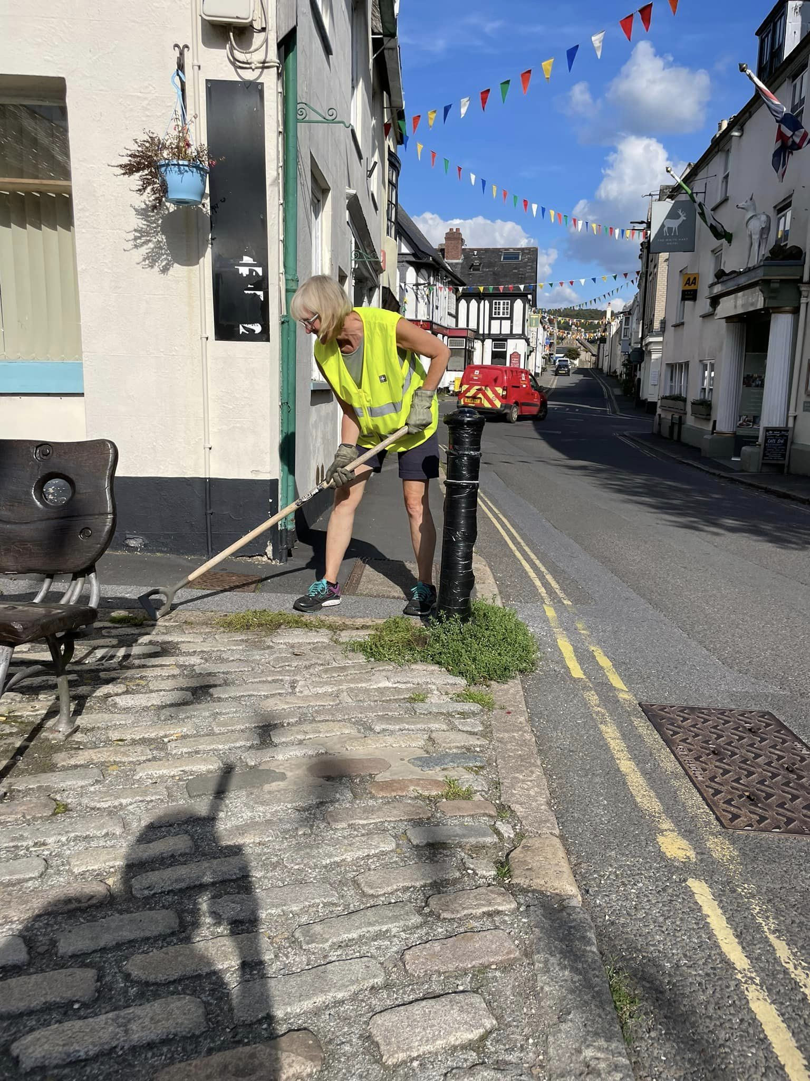
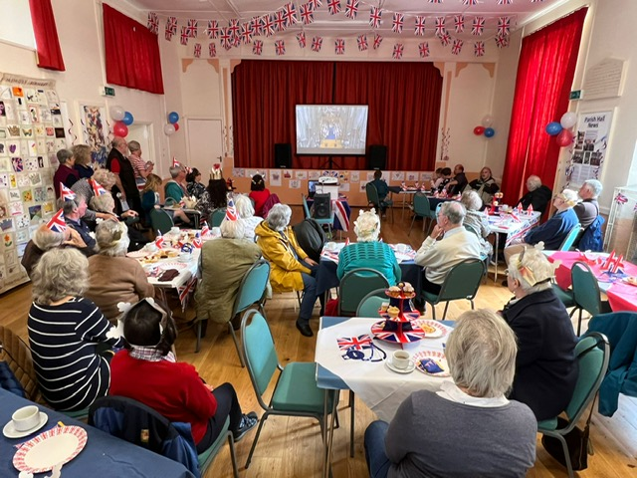
What does the Council do?
Involved in Community Events
Organise Litter Picks and Tidying events
Cream Tea for King’s Coronation

Slide 3
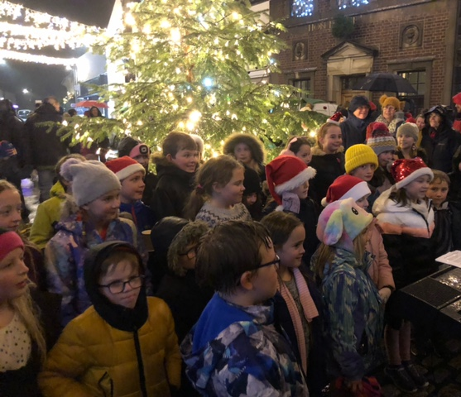
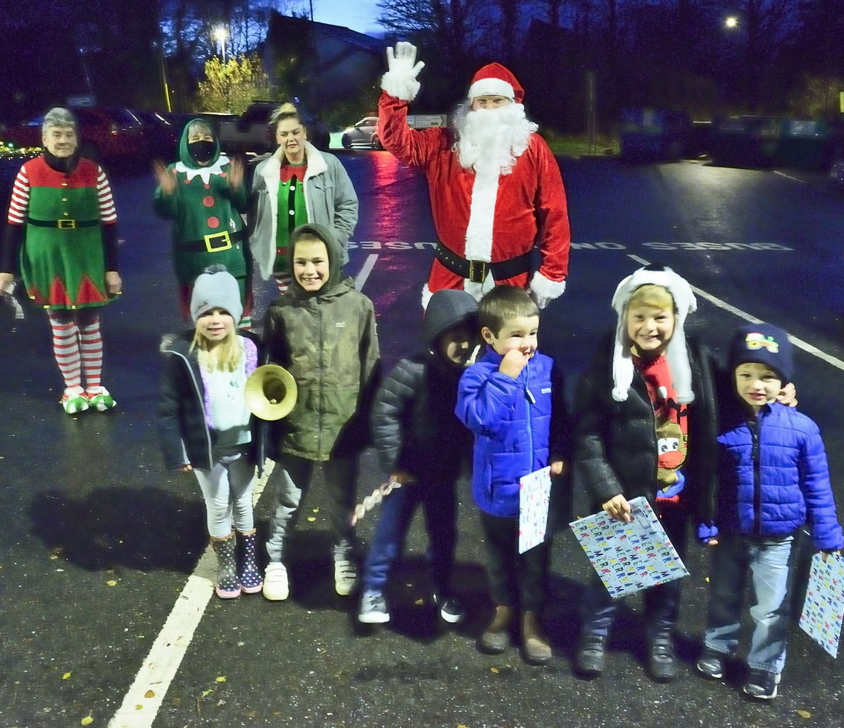
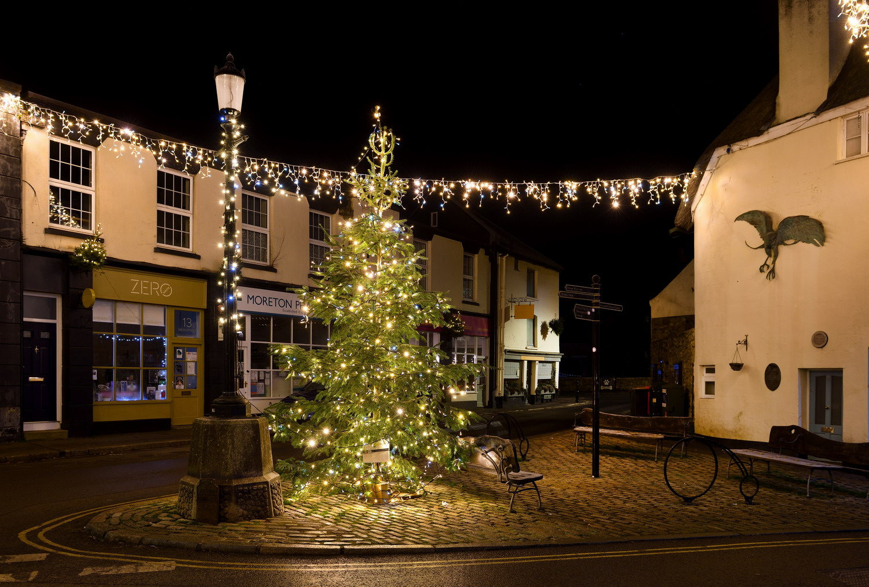
Christmas Celebrations

Slide 4
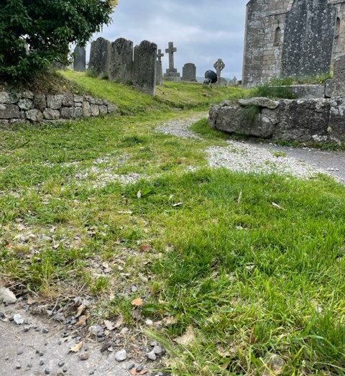
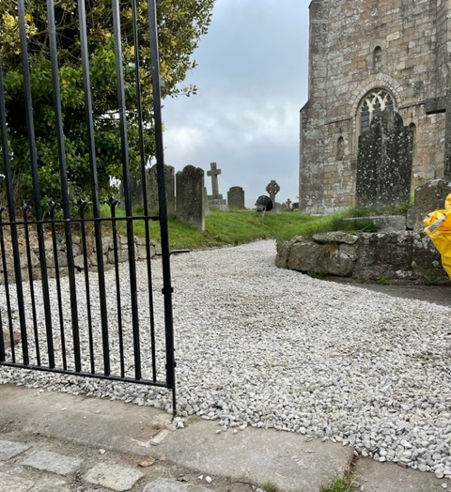
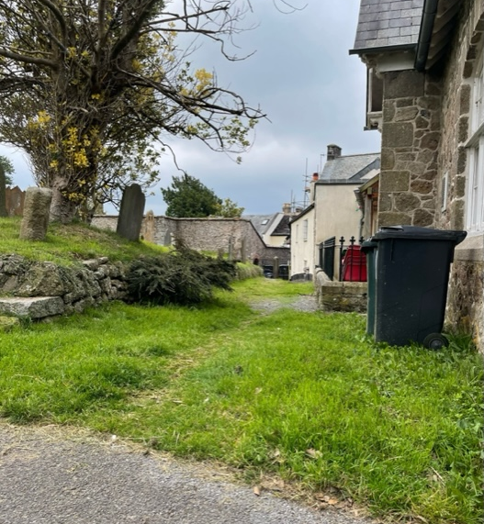
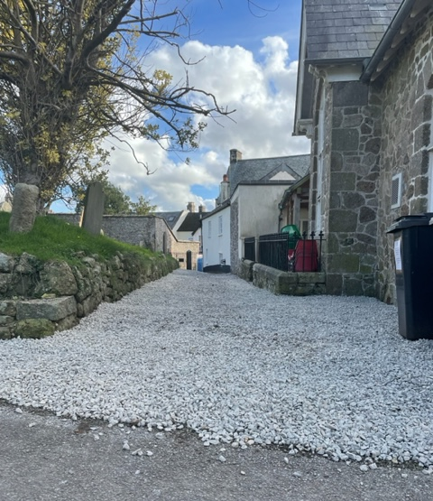
Restoring the Churchyard Paths

Slide 5
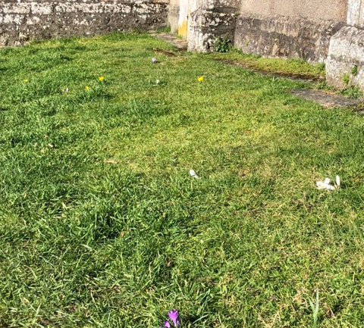
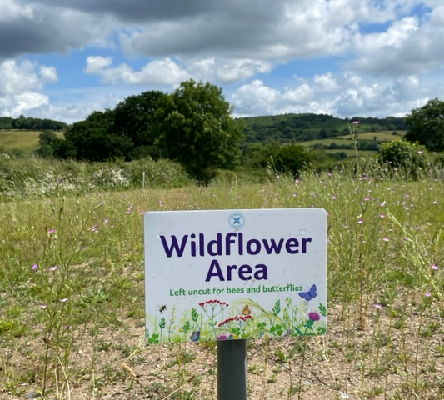
Biodiversity Projects in the Churchyard

Slide 6
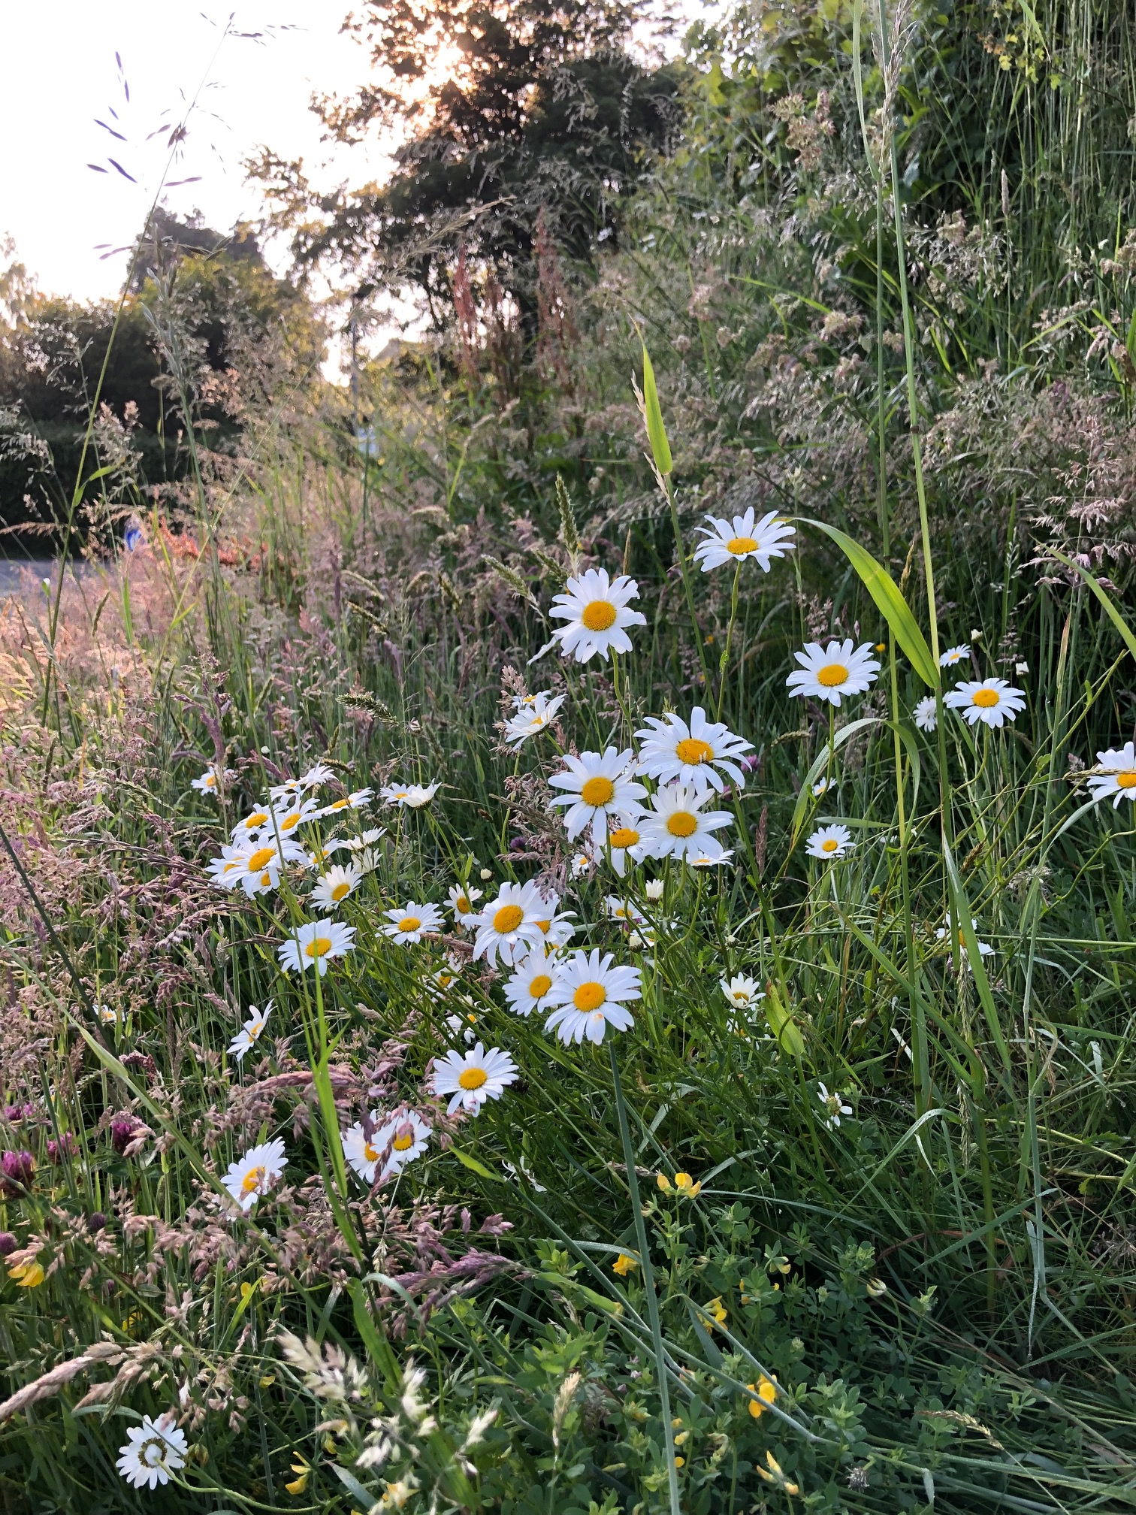
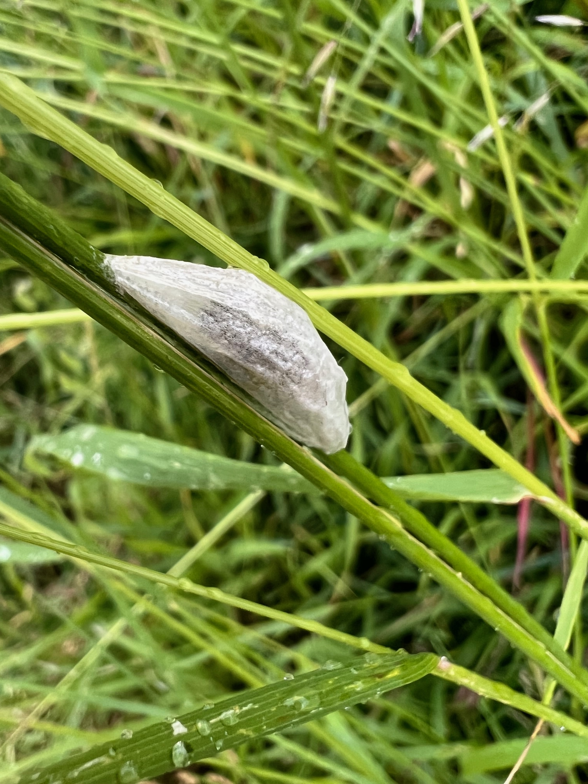
Biodiversity Projects by the Roadside

Slide 7
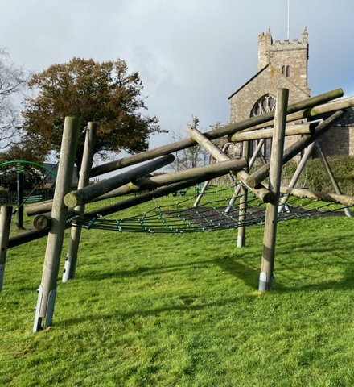
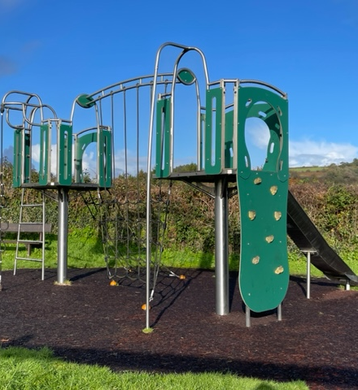
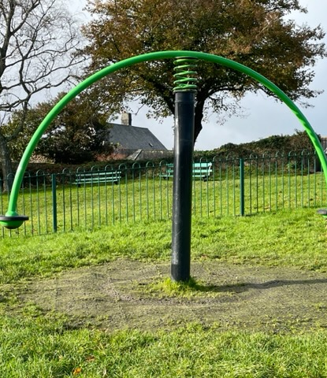
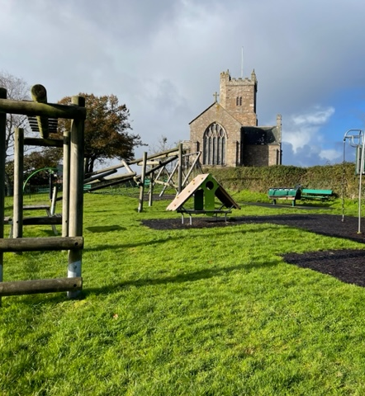
Look after the Playpark

Slide 8
Councillors
The Council has 12 Councillors
Attend meetings and make decisions that benefit the community
Volunteer at events
Represent the views of the community
Care about the environment
Repair and look after the council’s belongings such as benches and play equipment

Slide 9
Clerk
Makes sure the council doesn’t break the law
Looks after the council's money
Keeps everyone safe at the playpark
Organise events like the Jubilee celebrations and Christmas event
Helps the community
Keep the Sentry and Churchyard tidy

Slide 10
What do you know about the parish?
How many public seats do you think there are?
How long has the parish council been in existence?
How many allotment plots are there?
How many swings are there?
Why do people become parish councillors?

Slide 11
What do you want? The Parish Council works for you!
Would the school like to help the Parish Council?
Would you like to see more wildlife in Moreton?
Do you think we should make cars slow down?

